Slide 1
Scrum-Agile Methodology
By
Franklin Durbin

Slide 2
Scrum Team Roles
Scrum Master
Product Owner
Developer
Tester

Slide 3

Scrum Master
Helps adapt the “Agile” mentality.
Removes obstacle that may slow the team down.
Organizes the Scrum Events and oversees the team.
Helps coach individuality into teams.
Coaches the Scrum-Agile to fresh faces.

Slide 4
Product Owner
Interacts with the customer to find out what they desire out of their product.
Turns user stories into back log items.
Organizes and keeps the product backlog ordered.

Slide 5
Developer
Works on items off the product back log.
Attends Scrum Events and provides valued input.
Uses high quality coding techniques like extreme programming and codes just enough.
Checks if the code is suitable to pass the test cases.

Slide 6
Tester
Takes user stories from the Product Manager and develops test cases for the backlog items.
Tests code to ensure it is passing the test cases.
Attends Scrum Events and provides input.

Slide 7
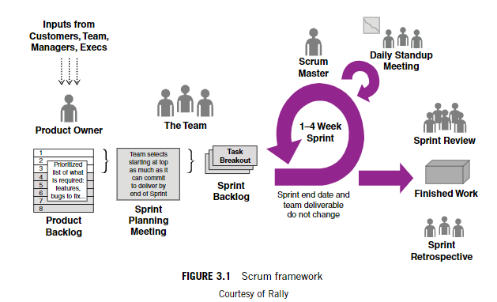
The Scrum Framework
(Cobb, 2015)

Slide 8
Sprint Planning
The sprint planning is the first part of the development process after the Product Owner gets their information from the customer. Here the amount of work or back log items is being negotiated between the development team and Product Owner. This allows for everyone to provide their input and to help keep from strict deadlines to rush work. The Product Owner should have already organized the backlog before this.

Slide 9
Daily Standup
This is a daily meeting between the whole team, that should only last around 15 minutes. There are a few questions each team member should answer.
What did you accomplish yesterday?
What are you going to accomplish today?
What obstacles are in your way?
(Cobb, 2015)

Slide 10
Sprint Retrospective
This is an opportunity to go back and talk about difficulties and lessons through out that sprint. Just like on a normal project, but since sprints are shorter periods of time this allows for more and quicker learning opportunities for the team members.

Slide 11
Why Agile and not Waterfall?
If we would have taken a Waterfall approach on the SNHU Travel project, things would not have gone as smoothly.
We went in with little exact information, so the likely hood of change was high.
We should still do upfront planning, but not try to anticipate change, rather accept it and work through it.
“The important point is that the terms plan-driven and adaptive are relative—they are not discrete, binary, mutually exclusive alternatives. They should imply a continuous range of approaches with different levels of upfront planning.” (Cobb, 2015)

Slide 12
References
Cobb, Charles (2015) The Project Manager's Guide to Mastering Agile : Principles and Practices for an Adaptive Approach [7,9,11]
https://web-a-ebscohost-com.ezproxy.snhu.edu/ehost/ebookviewer/ebook/bmxlYmtfXzkzNzAwOV9fQU41?sid=069d56be-544d-4f66-8fb8-39fbed31f764@sessionmgr4006&vid=0&format=EB&rid=1

